Slide 1
Neural Networks for Machine Learning

Slide 2
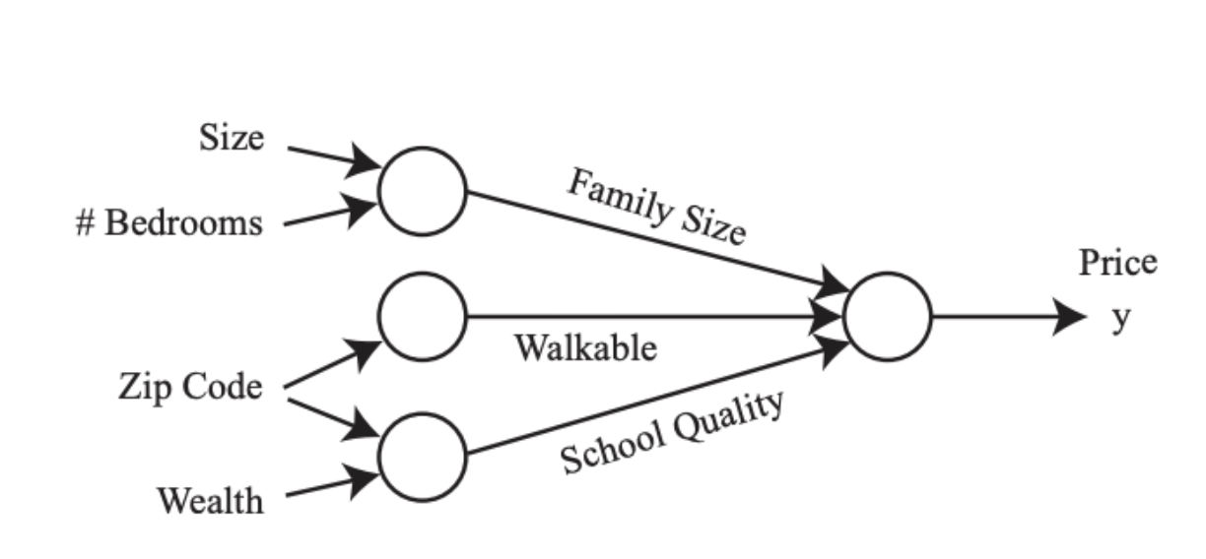

Slide 3
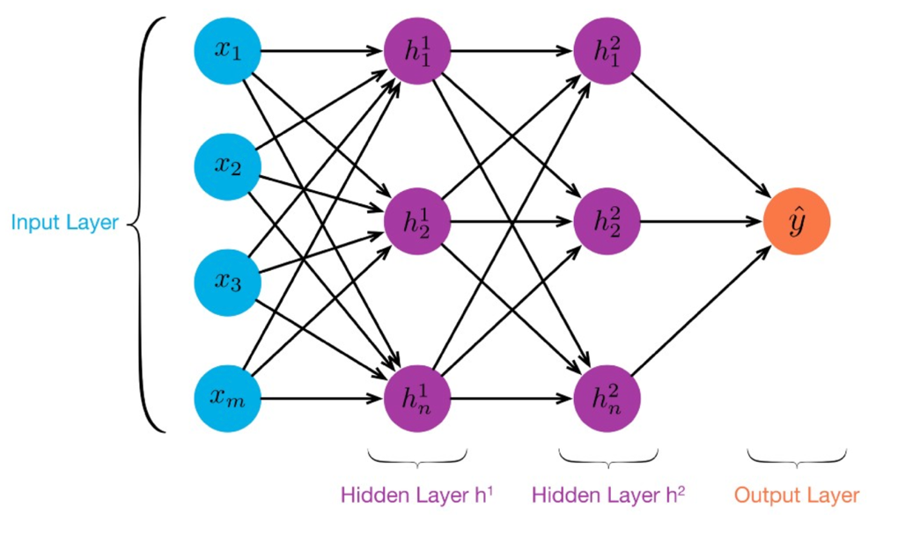
MLP: Multilayer Perceptron
≥ 1 “hidden layers” between inputs & output
Can compute non-linear functions (why?)
Training: adjust weights slightly to reduce error between output y and target value t; repeat
Introduced in 1980s, still used today

Slide 6
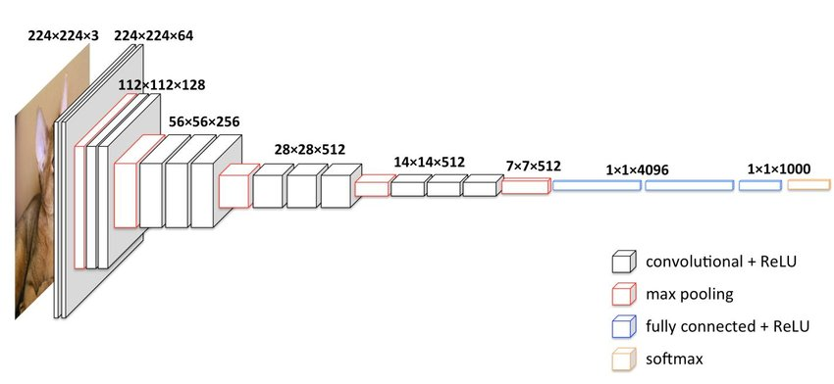
Deep Learning
Deep learning refers to models going beyond simple feed-forward multi-level perceptron
Though it was used in a ML context as early as 1986
“deep” refers to the models having many layers (e.g., 10-20) that do different things
22 layers!
The VGG16 CNN model for image processing

Slide 7
Neural Network Architectures
Current focus on large networks with different “architectures” suited for different tasks
Feedforward Neural Network
CNN: Convolutional Neural Network
RNN: Recurrent Neural Network
LSTM: Long Short Term Memory
GAN: Generative Adversarial Network
Transformers: generating output sequence from input sequence

Slide 8
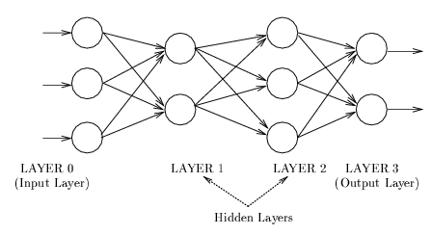
Feedforward Neural Network
Connections allowed from a node in layer i only to nodes in layer i+1, i.e., no cycles or loops
Simple, widely used architecture, provides a good baseline
Backpropagation used while training, of course
downstream nodes tend to successively abstract features from preceding layers

Slide 9
CNN: Convolutional Neural Network
Good for 2D image processing: classification, object recognition, automobile lane tracking, etc.
Successive convolution layers learn higher-level features
Classic demo: learn to recognize hand-written digits from MNIST data with 70K examples
In-Depth

Slide 10
RNN: Recurrent Neural Networks
Good for learning over sequences of data, e.g., a sentence of words
LSTM: (Long Short Term Memory) a popular architecture that remembers and uses previous N inputs
BI-LSTM: knows previous and upcoming inputs
Attention: recent idea that learns long-range dependencies between inputs
from Adam Geitgey

Slide 11
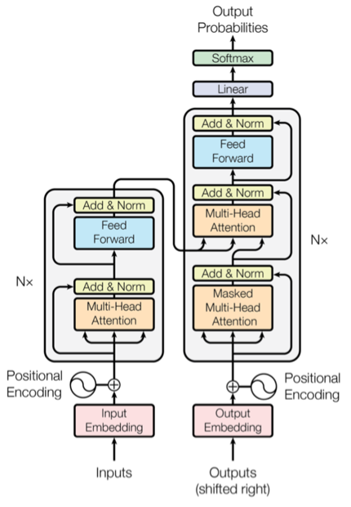
Transformer
Introduced in 2017 & has largely replaced RNNs
Used primarily for natural language & vision processing tasks
NLP applications ”transform” an input text into an output text
E.g., translation, summarization, question answering
Uses encoder-decoder architecture with attention
Popular pre-trainted models available, e.g. BERT and GPT

Slide 12
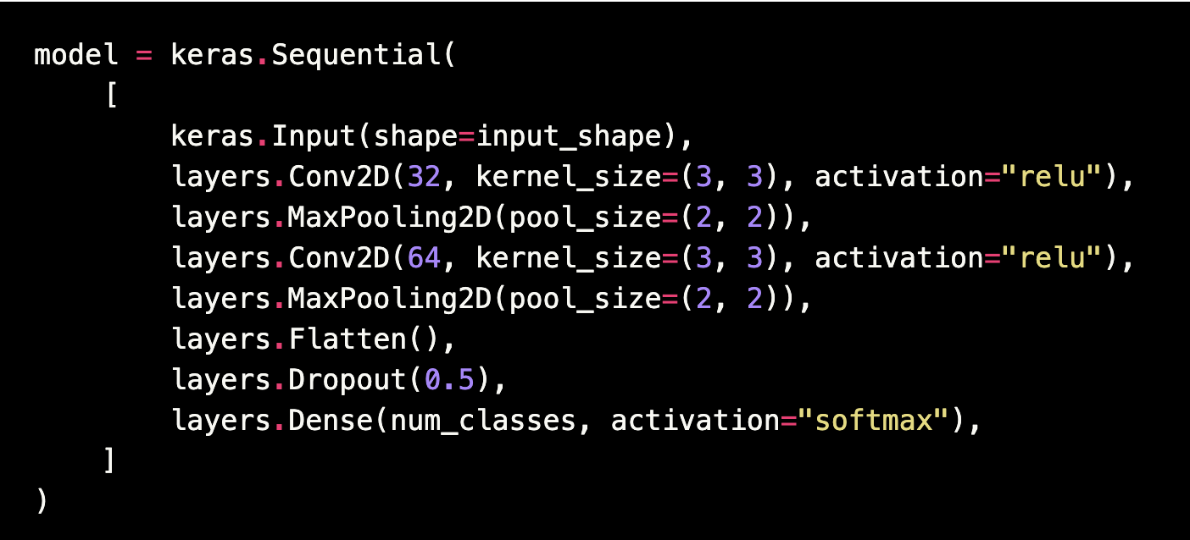
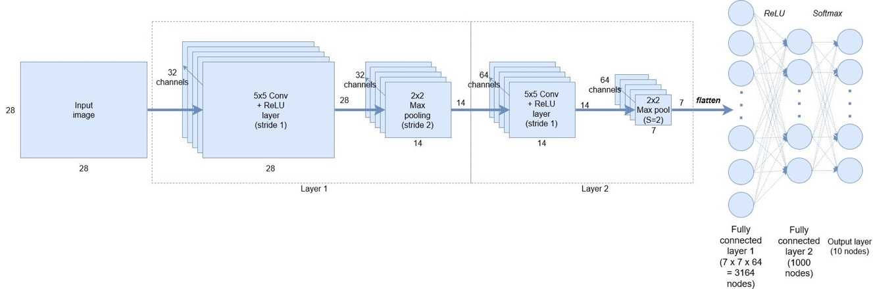
Keras: API works with TensorFlow
Example from a simple MNIST convolutional network
Notes:
Demo: MNIST CNN
Demo: RNN sentiment

Slide 13
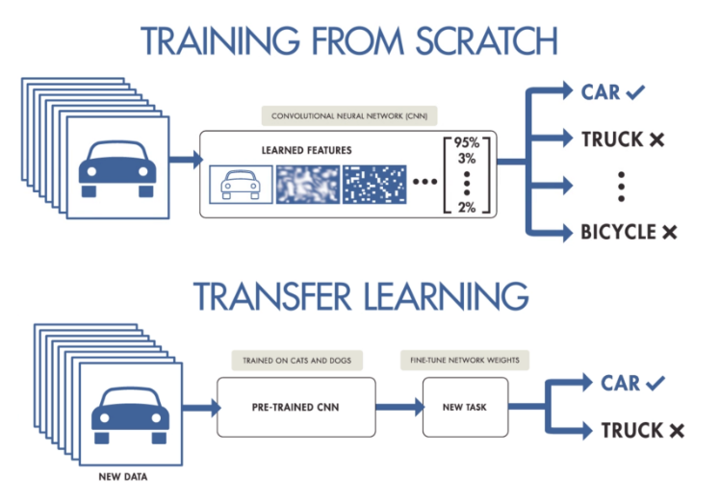
NNs Good at Transfer Learning
Neural networks effective for transfer learning
Using parts of a model trained on a task as an initial model to train on a different task
Particularly effective for image recognition and language understanding tasks

Slide 14
Good at Transfer Learning
For images, the initial stages of a model learn high-level visual features (lines, edges) from pixels
Final stages predict task-specific labels
source:http://ruder.io/transfer-learning/

Slide 15
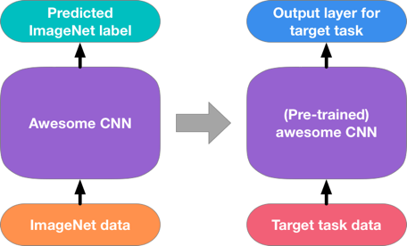
Fine Tuning a NN Model
Special kind of transfer learning
Start with a pre-trained model
Replace last output layer(s) with a new one(s)
One option: Fix all but last layer by marking as trainable:false
Retraining on new task and data very fast
Only the weights for the last layer(s) are adjusted
Example
Start: NN to classify animal pix with 100s of categories
Finetune on new task: classify pix of 10 common pets

Slide 16
More details
Training Approach:
In TL, we freeze all the pre-trained layers and only train the new layers added on top.
In FT, unfreeze some of the pre-trained layers and allow them to be updated during training.
Domain Similarity: Transfer learning is suitable when the new task or domain is somewhat similar to the original task or domain on which the pre-trained model was trained. Fine-tuning is more effective when the new dataset is large enough and closely related to the original dataset.

Slide 17
More details
Computational Resources: Transfer learning requires fewer computational resources since only the new layers are trained. Fine-tuning, on the other hand, may require more resources, especially if we unfreeze and update a significant number of pre-trained layers.
Training Time: Transfer learning generally requires less training time since we are training fewer parameters. Fine-tuning may take longer, especially if we are updating a larger number of pre-trained layers.

Slide 18
More details
Dataset Size: Transfer learning is effective when the new dataset is small, as it leverages the pre-trained model’s knowledge on a large dataset. Fine-tuning is more suitable for larger datasets, as it allows the model to learn more specific features related to the new task. It’s important to note that the choice between fine-tuning and transfer learning depends on the specific task, dataset, and available computational resources. Experimentation and evaluation are key to determining the most effective approach for a given scenario.

